Slide 1
Continued………
Unit -2
Threads and
Processes

Slide 2
Objectives
To introduce the notion of a thread — a smallest dispatchable unit of CPU utilization that forms the basis of multithreaded computer systems
To examine issues related to multithreaded programming

Slide 3
1. Process
Resource ownership - process is allocated a virtual address space to hold the process image
Scheduling/execution - follows an execution path that may be interleaved with other processes
These two characteristics are treated independently by the operating system

Slide 4
Process
Dispatching is referred to as a thread
Resource of ownership is referred to as a process or task
Protected access to processors, other processes, files, and I/O resources

Slide 5
2. Multithreading
Operating system supports multiple threads of execution within a single process
MS-DOS supports a single thread
UNIX supports multiple user processes but only supports one thread per process
Windows 2000, Solaris, Linux, Mach, and OS/2 support multiple threads

Slide 6
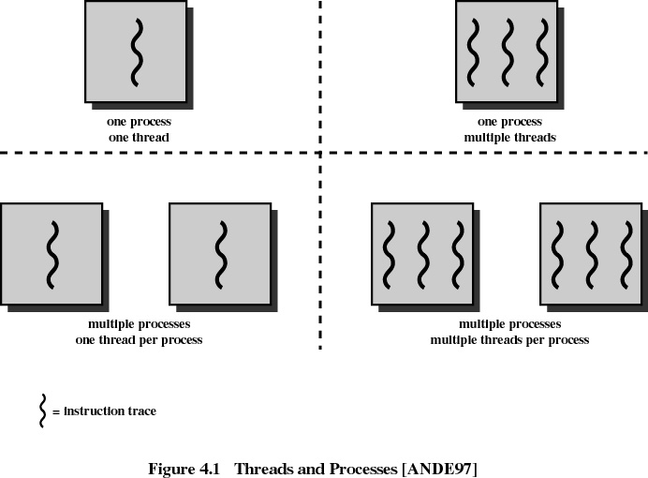

Slide 7

Single and Multithreaded Processes

Slide 8
3. Thread
An execution state (running, ready, etc.)
Saved thread context when not running
Has an execution stack
Some per-thread static storage for local variables
Access to the memory and resources of its process
  all threads of a process share this

Slide 9
Threads
Suspending a process involves suspending all threads of the process since all threads share the same address space
Termination of a process, terminates all threads within the process

Slide 10
Benefits of Threads
Takes less time to create a new thread than a process
Less time to terminate a thread than a process
Less time to switch between two threads within the same process
Since threads within the same process share memory and files, they can communicate with each other without invoking the kernel

Slide 11
Uses of Threads in a Single-User Multiprocessing System
Foreground to background work
Asynchronous processing
Speed execution
Modular program structure

Slide 12
4. Thread States
States associated with a change in thread state
  Spawn
    Issue another thread
  Block
  Unblock
  Finish
    Deallocate register context and stacks

Slide 13
5. Levels of Threads
5.1 User-Level Threads
  All thread management is done by the application
  The kernel is not aware of the existence of threads

Slide 14
5.2 Kernel-Level Threads
  W2K, Linux, and OS/2 are examples of this approach
  Kernel maintains context information for the process and the threads
  Scheduling is done on a thread basis

Slide 15
5.3 Combined Approaches
  Example is Solaris
  Thread creation done in the user space
  Bulk of scheduling and synchronization of threads done in the user space

Slide 16
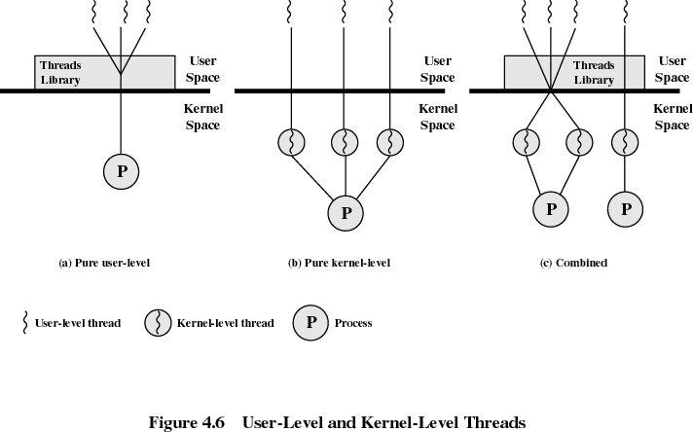

Slide 17
Relationship Between Threads and Processes
Threads:Process
Description
Example Systems
1:1
Each thread of execution is a
unique process with its own
address space and resources.
Traditional UNIX
implementations
M:1
A process defines an address
space and dynamic resource
ownership. Multiple threads
may be created and executed
within that process.
Windows NT,
Solaris, OS/2,
OS/390, MACH

Slide 18
Relationship Between Threads and Processes
Threads:Process
Description
Example Systems
1:M
A thread may migrate from one
process environment to
another. This allows a thread
to be easily moved among
distinct systems.
Ra (Clouds), Emerald
M:M
Combines attributes of M:1
and 1:M cases
TRIX

